Slide 1
Classroom slides - Interrupts

Slide 2
Interrupts/Exceptions/Traps
 | Sync/Async | Source | Intentional? | Examples
Exception | Sync | Internal | No | Overflow, Divide by zero
Trap | Sync | Internal | Yes | System Call
Interrupt | Async | External | Yes | I/O Device Completion

Slide 3
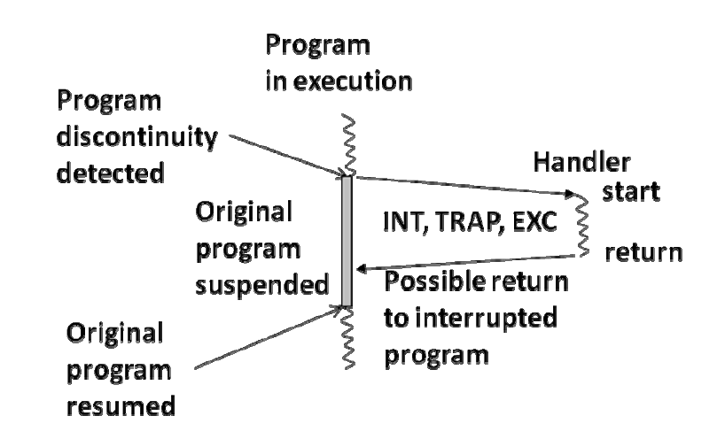

Slide 4
New internal processor register
Exception/Trap number
ETR

Slide 5
Handler code for divide by zero exception
0
Handler address
for divide by zero exception
Handler code for overflow exception
1
Handler address
for arithmetic overflow
Table entries for
exceptions
……..
Handler code for system call trap
.
.
.
.
.
.
.
.
Handler address
for system call trap
Table entries for
traps
Handler address
for page fault trap
Handler code for page fault trap
……..
Handler address
for KBD interrupt
Handler code for KBD interrupt
Table entries for
External interrupts
Handler address
for mouse interrupt
………
Handler code for mouse interrupt
n-1

Slide 6
Fetch
Decode
Execute
INT = n
INT = y
INT
$k0 PC
PC new PC

Slide 7
Original program
$ko return address for
original program
First interrupt handler
$ko return address for
first interrupt handler
Second interrupt handler

Slide 8
Handler:
save $k0;
save processor registers;
execute device code;
restore processor registers;
restore $k0;
return to original program;

Slide 9
Fetch
Decode
Execute
INT = n
INT = y
INT
$k0 PC
PC new PC
Disable interrupts

Slide 10
Handler:
/* The interrupts are disabled when we enter */
save $k0;
enable interrupts;
save processor registers;
execute device code;
restore processor registers;
disable interrupts;
restore $k0;
return to original program; /* how? */

Slide 11
Handler:
/* The interrupts are disabled when we enter */
save $k0;
enable interrupts;
save processor registers;
execute device code;
restore processor registers;
disable interrupts;
restore $k0;
return from interrupt;
/* interrupts enabled by return from interrupt */

Slide 12
Processor
Address Bus
Data Bus
INT
INTA
Device 1
Device 2

Slide 13
INT8
INTA 8
Device 1
Device 2
.
.
.
.
.
.
.
.
Priority
Encoder
Processor
INT
INT1
INTA
INTA 1
Device 1
Device 2

Slide 14
Address of handler
KEYBOARD
80
81
….
Address of handler
MOUSE
82
83
….
Memory
.
.
.
.
Interrupt vector table
Address Bus
Processor
Data Bus
INT
INTA
Device 1
Device 2

Slide 15
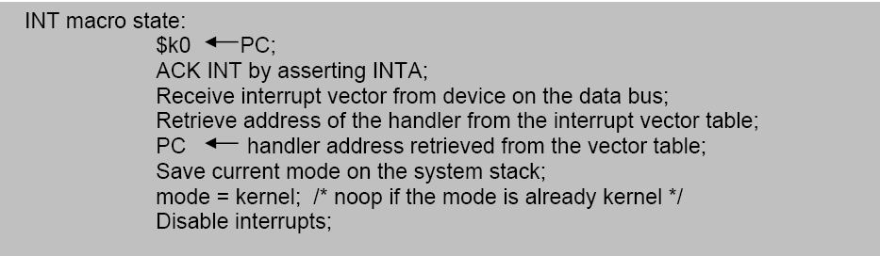
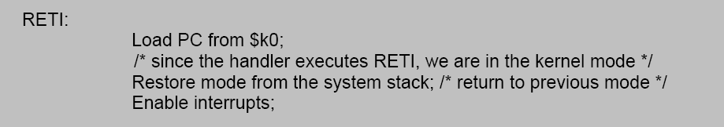

Slide 16
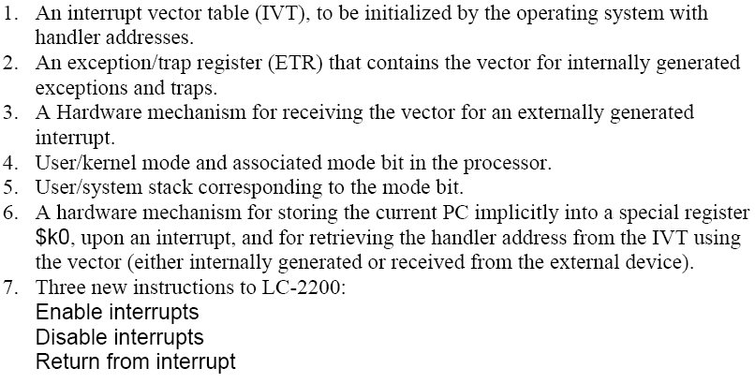
Arch enhancements to LC-2200

Slide 17
A.
Executing instruction at 19999. The PC has already been incremented. Device signals interrupt in middle of instruction. $sp points to user stack
INT REQ
1
MODE
USER
INT ACK
0
Register File
INT Enable
1
$k0
300
PC
20000
$sp
user
stack
ADDR
40
41
•
•
•
299
300
•
•
•
1000
1001
•
•
•
19999
20000
CONT
1000
...
...
...
inst
inst
inst
inst
Vector Table
System Stack
Handler Code
Original Program

Slide 18
B.
Interrupt has been sensed. $k0 gets PC. Interrupts are disabled. Interrupt is acknowledged. Device puts vector on bus.
INT REQ
1
MODE
USER
INT ACK
1
Register File
INT Enable
0
$k0
20000
BUS
40
PC
20000
$sp
user
stack
ADDR
40
41
•
•
•
299
300
•
•
•
1000
1001
•
•
•
19999
20000
CONT
1000
...
...
...
inst
inst
inst
inst
Vector Table
System Stack
Handler Code
Original Program

Slide 19
C.
Handler address is put into PC;
Current mode is saved in system stack; New mode is set to kernel; $sp now points to system stack; Interrupt code at 1000 is set to handle the interrupt.
INT REQ
0
MODE
KERNEL
INT ACK
0
Register File
INT Enable
0
$k0
20000
PC
1000
$sp
299
ADDR
40
41
•
•
•
299
300
•
•
•
1000
1001
•
•
•
19999
20000
CONT
1000
...
...
mode
inst
inst
inst
inst
Vector Table
System Stack
Handler Code
Original Program

Slide 20
D.
RETI instruction restores mode from system stack; since returning to user program in this example, $sp now points to user stack; also, copies $k0 into PC, re-enables interrupts and sets Mode to User
INT REQ
0
MODE
USER
INT ACK
0
Register File
INT Enable
1
$k0
20000
PC
20000
$sp
user
stack
ADDR
40
41
•
•
•
299
300
•
•
•
1000
1001
•
•
•
19999
20000
CONT
1000
...
...
...
inst
inst
inst
inst
Vector Table
System Stack
Handler Code
Original Program

Slide 21
A.
Executing instruction at 19999. The PC has already been incremented. Device signals interrupt in middle of instruction. $sp points to user stack
INT REQ
1
MODE
USER
INT ACK
0
Register File
INT Enable
1
$k0
300
PC
20000
$sp
user
stack
ADDR
40
41
•
•
•
299
300
•
•
•
1000
1001
•
•
•
19999
20000
CONT
1000
...
...
...
inst
inst
inst
inst
Vector Table
System Stack
Handler Code
Original Program
B.
Interrupt has been sensed. $k0 gets PC. Interrupts are disabled. Interrupt is acknowledged. Device puts vector on bus.
INT REQ
1
MODE
USER
INT ACK
1
Register File
INT Enable
0
$k0
20000
BUS
40
PC
20000
$sp
user
stack
ADDR
40
41
•
•
•
299
300
•
•
•
1000
1001
•
•
•
19999
20000
CONT
1000
...
...
...
inst
inst
inst
inst
Vector Table
System Stack
Handler Code
Original Program
C.
Handler address is put into PC;
Current mode is saved in system stack; New mode is set to kernel; $sp now points to system stack; Interrupt code at 1000 is set to handle the interrupt.
INT REQ
0
MODE
KERNEL
INT ACK
0
Register File
INT Enable
0
$k0
20000
PC
1000
$sp
299
ADDR
40
41
•
•
•
299
300
•
•
•
1000
1001
•
•
•
19999
20000
CONT
1000
...
...
mode
inst
inst
inst
inst
Vector Table
System Stack
Handler Code
Original Program
D.
RETI instruction restores mode from system stack; since returning to user program in this example, $sp now points to user stack; also, copies $k0 into PC, re-enables interrupts and sets Mode to User
INT REQ
0
MODE
USER
INT ACK
0
Register File
INT Enable
1
$k0
20000
PC
20000
$sp
user
stack
ADDR
40
41
•
•
•
299
300
•
•
•
1000
1001
•
•
•
19999
20000
CONT
1000
...
...
...
inst
inst
inst
inst
Vector Table
System Stack
Handler Code
Original Program

